Slide 1
Speedbump Detection and Distance Measurement
Final Project for Computer Vision
Team Members：
2250758 Jishen Lin
2251730 Shuyi Liu
2024 / 12 / 27

Slide 2
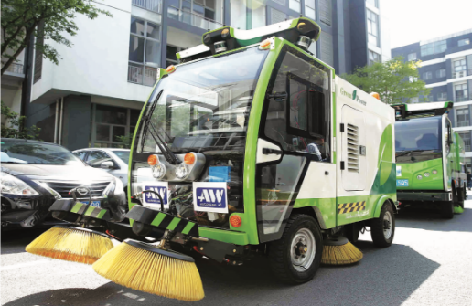
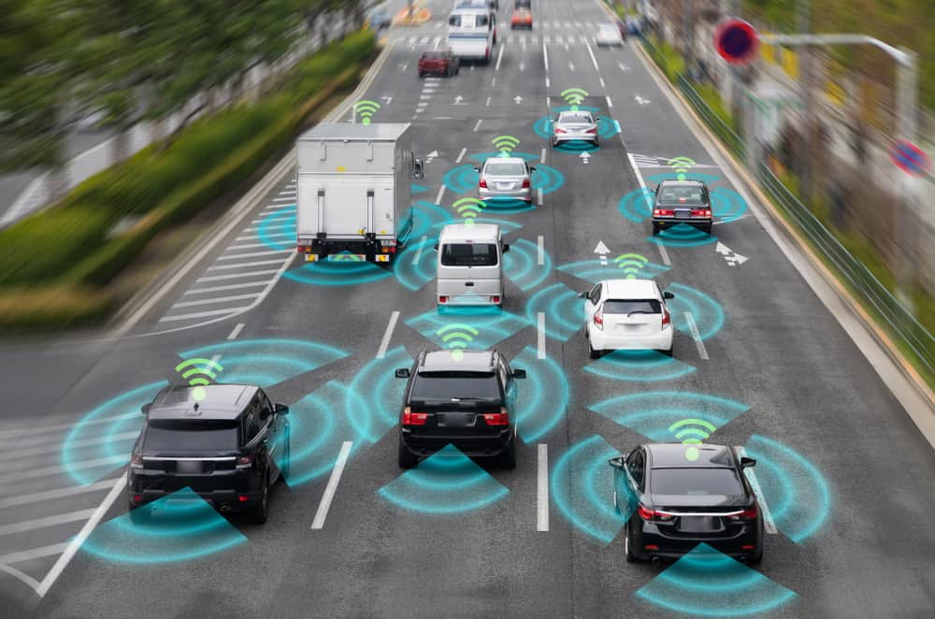
Application Scenarios
Intelligent Driving Systems
Identify speed bumps and decelerate in advance to enhance driving safety and ride comfort.
Integrate with high-precision maps to predict speed bumps and plan routes accordingly.
Advanced Driver Assistance Systems (ADAS)
Alert drivers to the presence of speed bumps, avoiding sudden braking or discomfort.
Autonomous Vehicles
In autonomous driving scenarios, speed bump recognition and distance measurement are critical inputs for path planning and speed control.
Road Maintenance and Management
Collect speed bump data through onboard sensors to assess their location and condition, providing insights for road maintenance.

Slide 3
1
Camera Calibration
Camera Calibration and Obtaining Intrinsic Parameters
2
Homographic Matrix Estimation
Calculating Homography Matrix Between Camera and Road Surface
Steps
3
Target Detection
Implementing Speedbump Detection Using YOLOv8
4
Distance Measurement
Measuring the Distance Between the Camera and the Speedbump
5
Results Presentation
Speedbump Detection and Distance Measurement

Slide 4

01
Camera Calibration
Camera Calibration and Obtaining Intrinsic Parameters

Slide 5
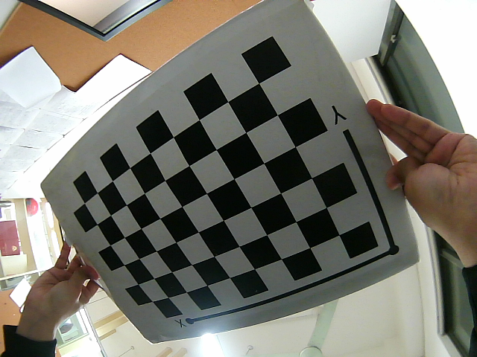
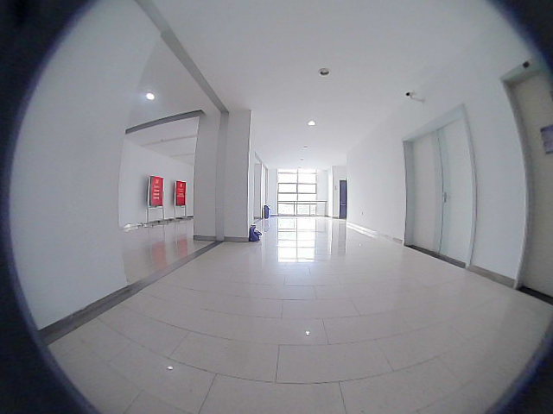
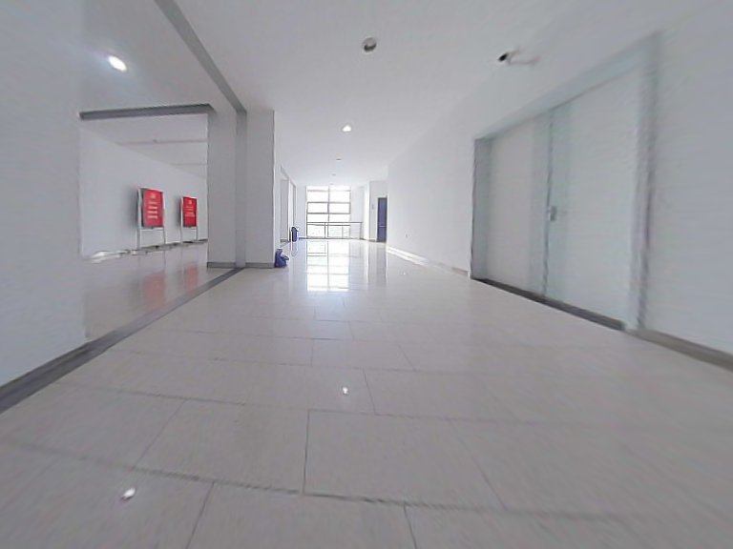
Camera Calibration
Camera calibration aims to obtain the camera's internal parameters, which define its imaging properties, and external parameters, which describe its position and orientation in the world. For our project, it forms the basis for speed bump detection and distance measurement.
Chessboard Calibration
We use a chessboard as the calibration object. Its regular pattern allows accurate corner detection, and the known square size helps generate 3D coordinates for each corner, serving as reference points.
Corner Detection with OpenCV
Using findChessboardCorners function, we detect the chessboard corners in the image. The 2D coordinates of these corners correspond to the pre-defined 3D world coordinates.
Camera Calibration and Correction
We calibrate the camera using cv2.calibrateCamera or cv2.fisheye.calibrate, obtaining internal parameters (e.g., focal length, distortion coefficients) and external parameters (e.g., rotation and translation). These are used to correct image distortion and produce undistorted images.

Slide 6
02
Homographic Matrix Estimation
Calculating Homography Matrix Between Camera and Road Surface

Slide 7
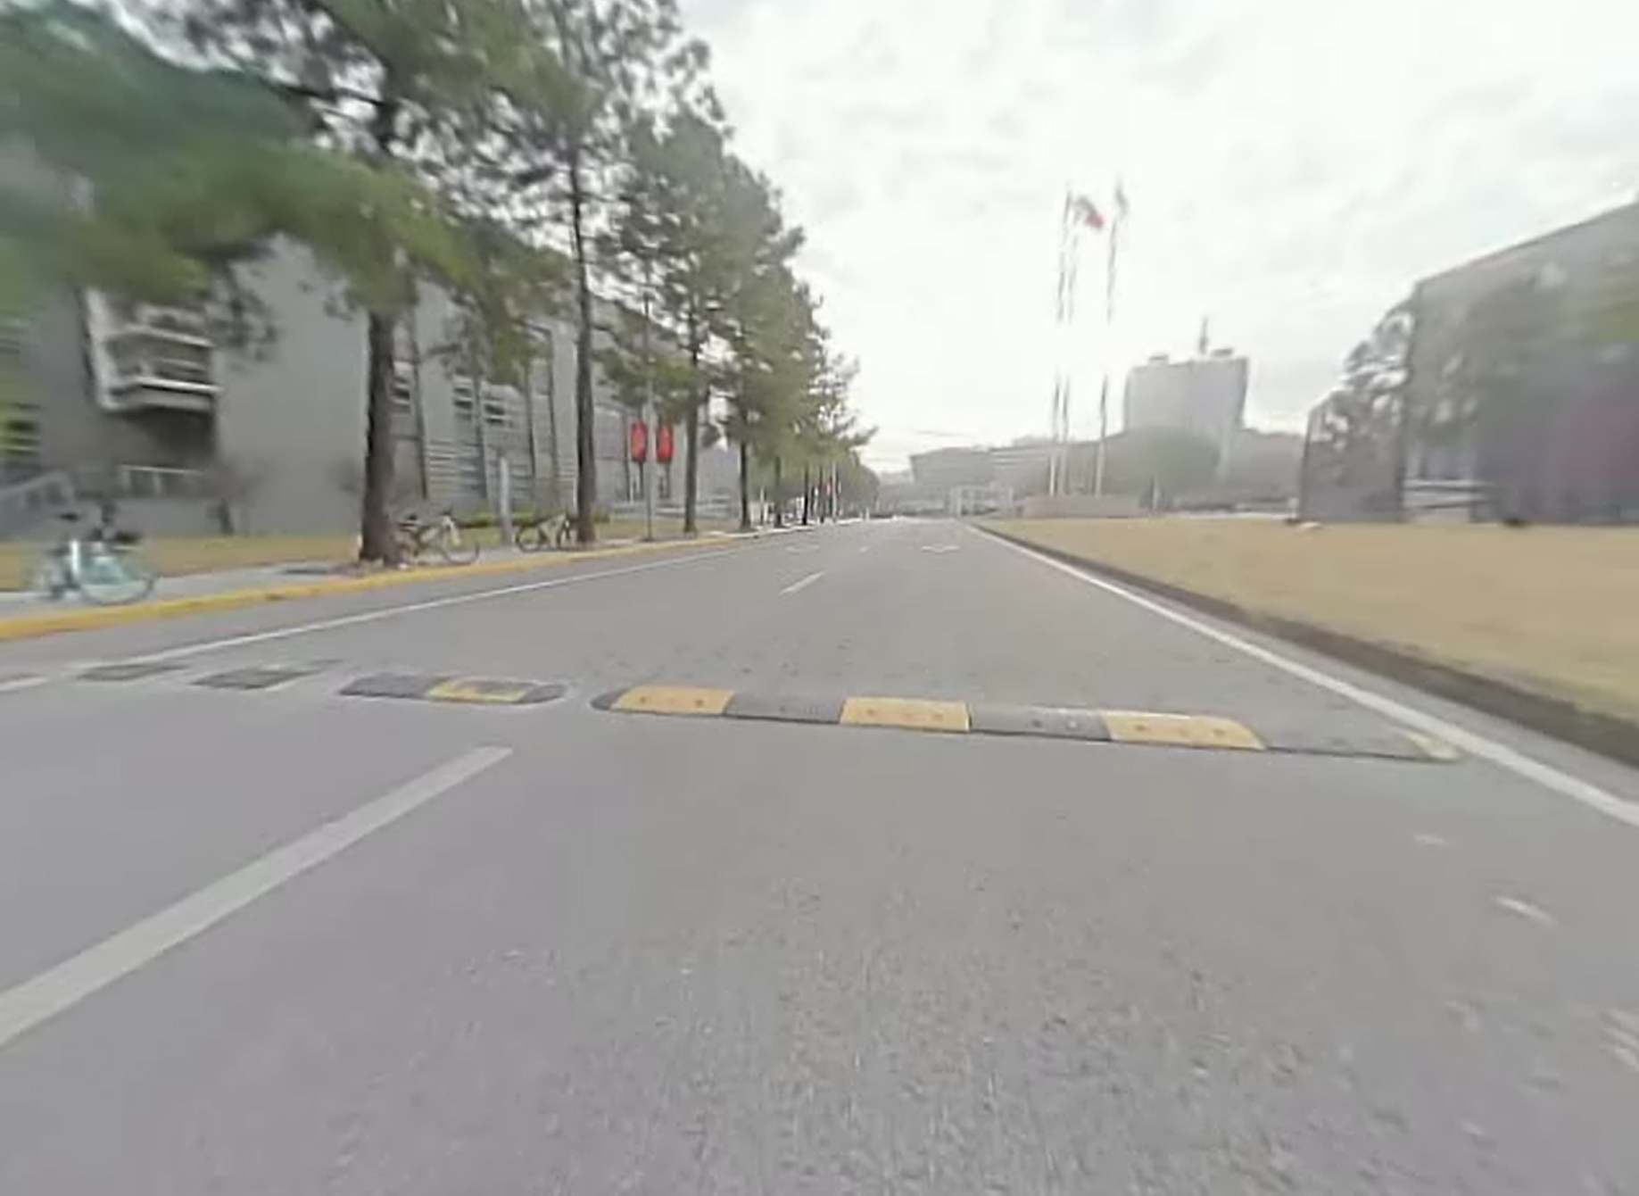
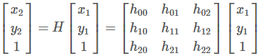
Homographic Matrix Estimation
The homography transformation matrix is a 3x3 matrix used to describe the projective relationship between two 2D planes. In our project, the homography transformation matrix is used to map 2D points in the image to 2D points on the road plane.
We assume that the road is flat, and by selecting known feature points on the road surface, we can obtain a set of corresponding 2D image points and 2D road plane points.
OpenCV provides the cv2.findHomography function to compute the homography transformation matrix. This function calculates the projective relationship from the image plane to the road plane by minimizing the reprojection error based on the user-provided corresponding points. Its principle is grounded in the analytical solution of a system of linear equations and Singular Value Decomposition (SVD), offering an efficient method for computer vision tasks.

Slide 8
03
Target Detection
Implementing Speedbump Detection Using YOLOv8

Slide 9
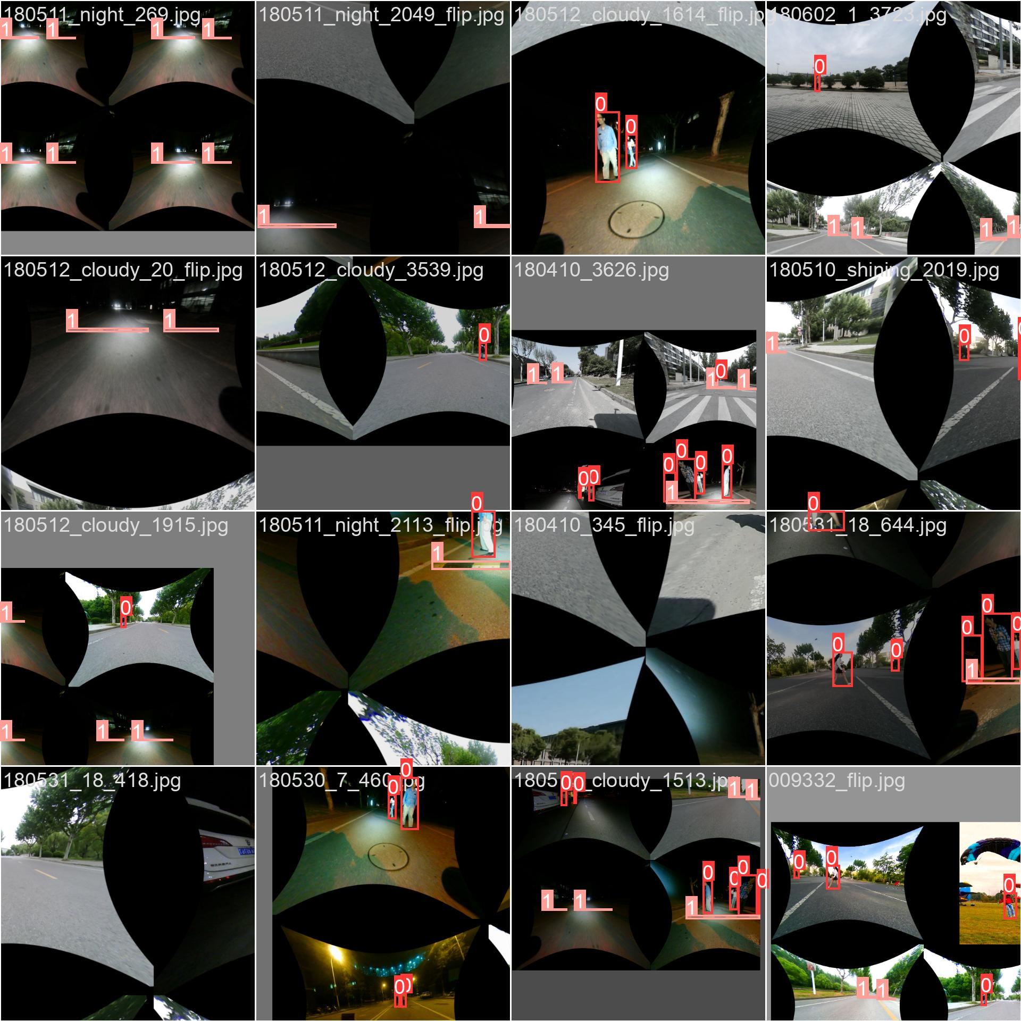
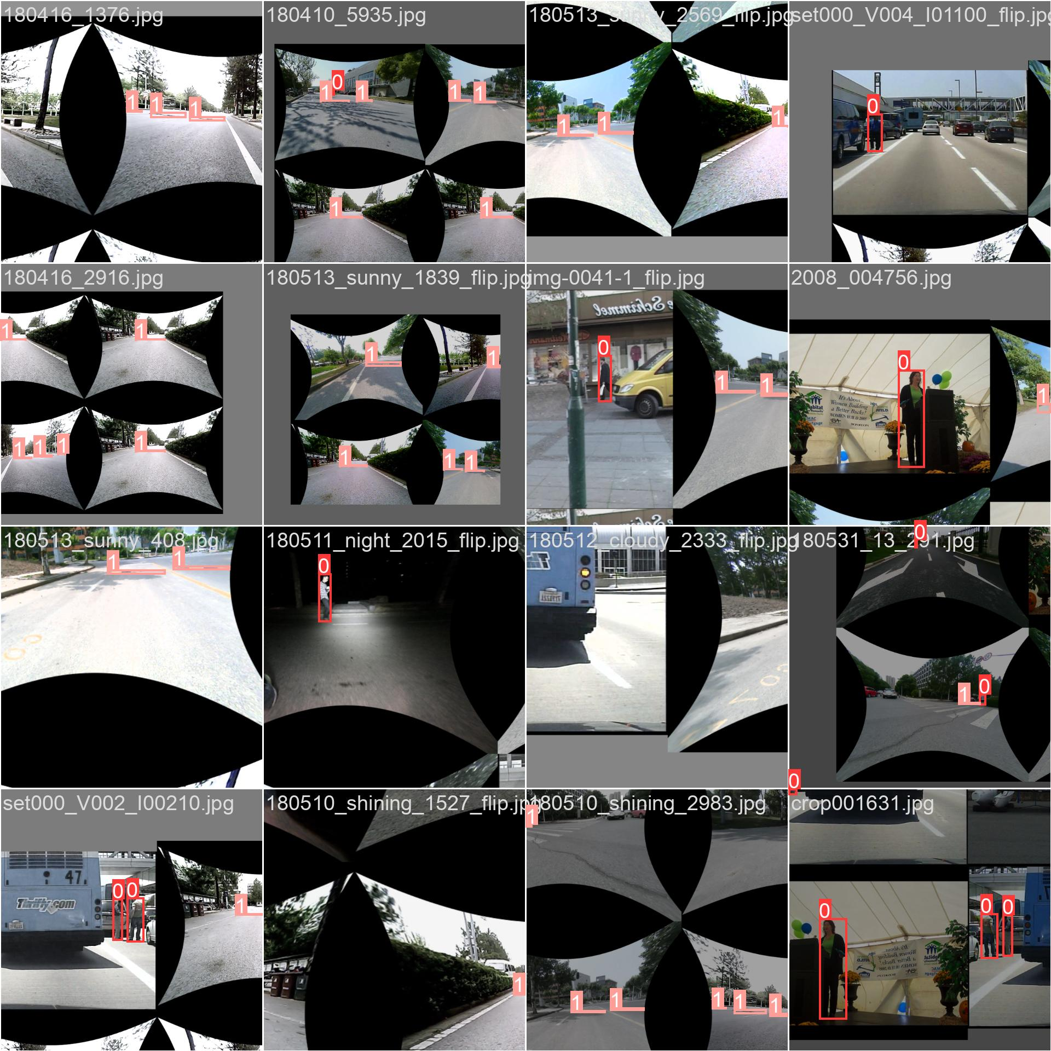

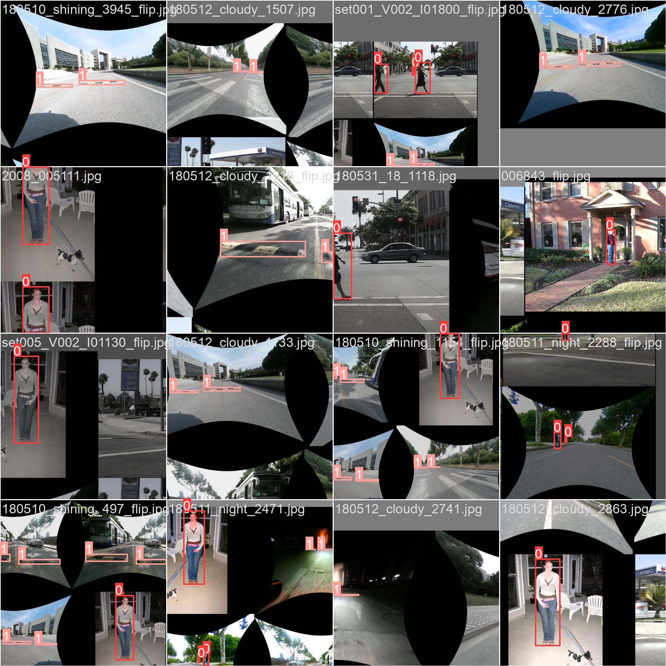
Target Detection
Dataset Composition
Known Dataset from HW3
This dataset already includes annotated speed bump images, which can be directly used for training.
Images Extracted from Real-World Videos
We extracted multiple frames from actual videos and manually annotated the positions and categories of speed bumps using the LabelImg tool.
These images cover various lighting conditions, angles, and backgrounds, enhancing the model's generalization ability.
Dataset Splitting
To ensure the model's generalization capability, we divided the dataset as follows:
70% for Training: Used to train the model.
20% for Validation: Used to evaluate the model's performance during training.
10% for Testing: Used for the final evaluation of the model's performance.
Model Training
Epochs | 100 | Optimizer | auto
Batch Size | 16 | Learning Rate | 0.01
Image Size | 640 | Momentum | 0.937
Device | 0 (GPU) | Weight Decay | 0.0005
Workers | 8 | Warmup Epochs | 3.0
Pretrained | true | Label Smoothing | 0.0

Slide 10
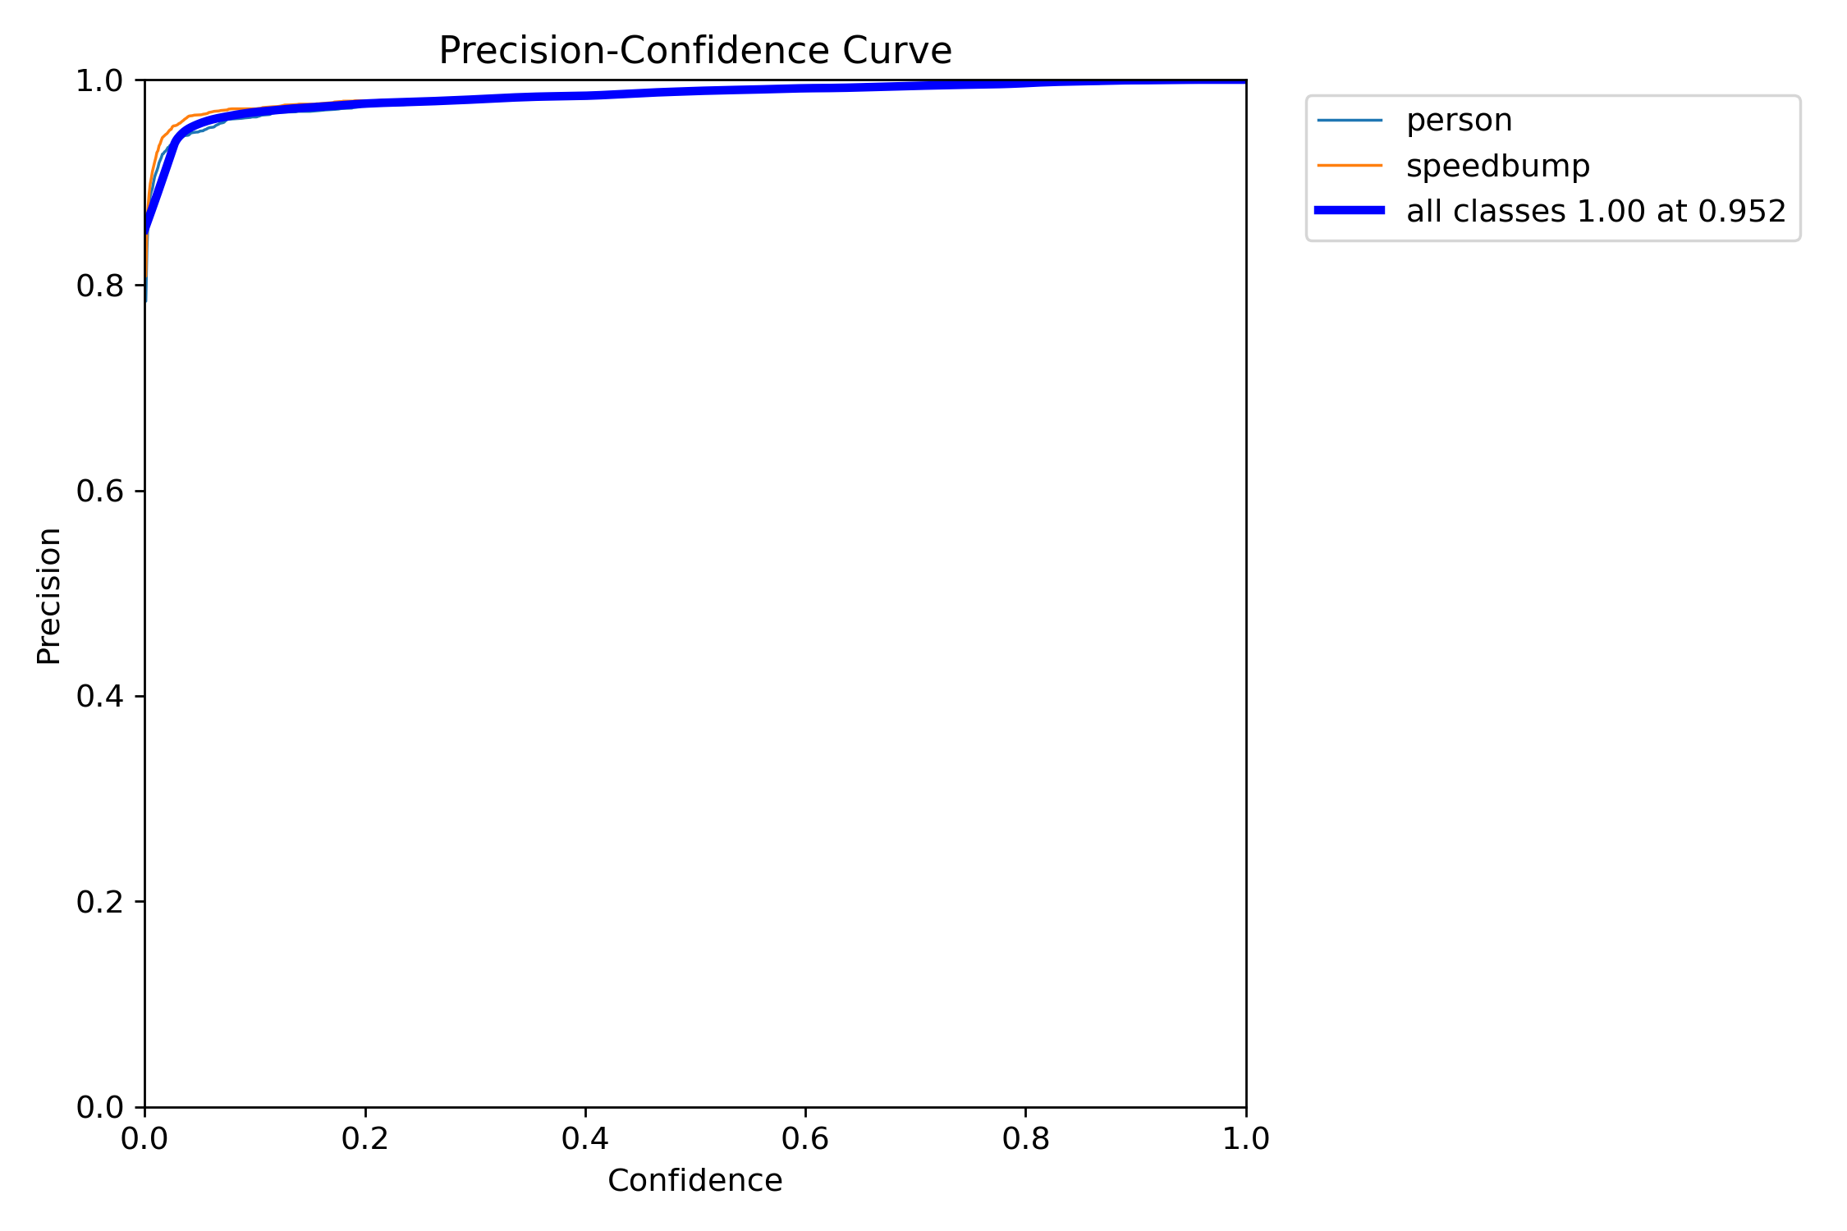
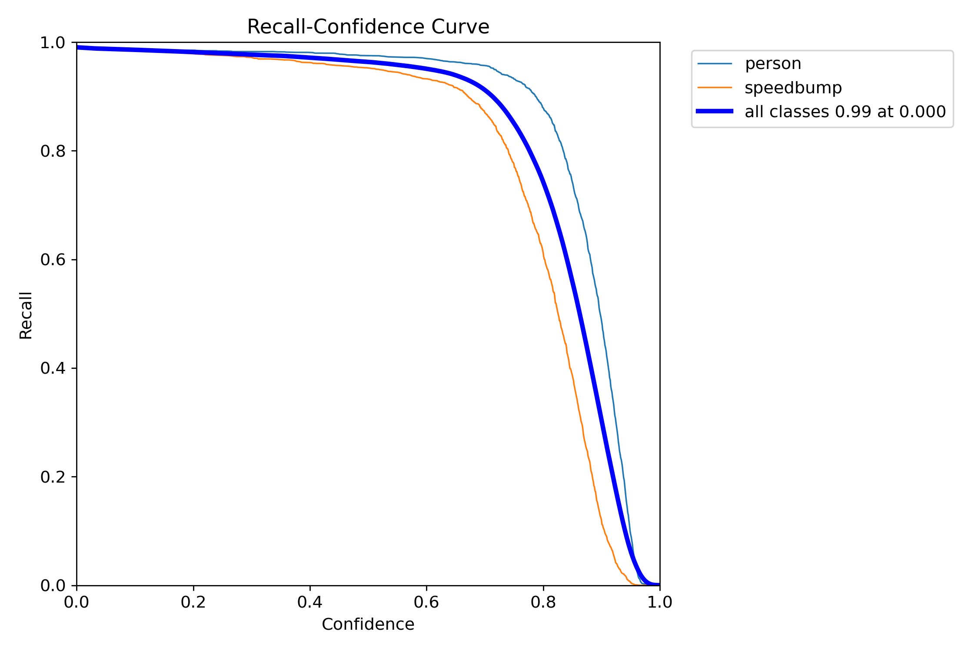
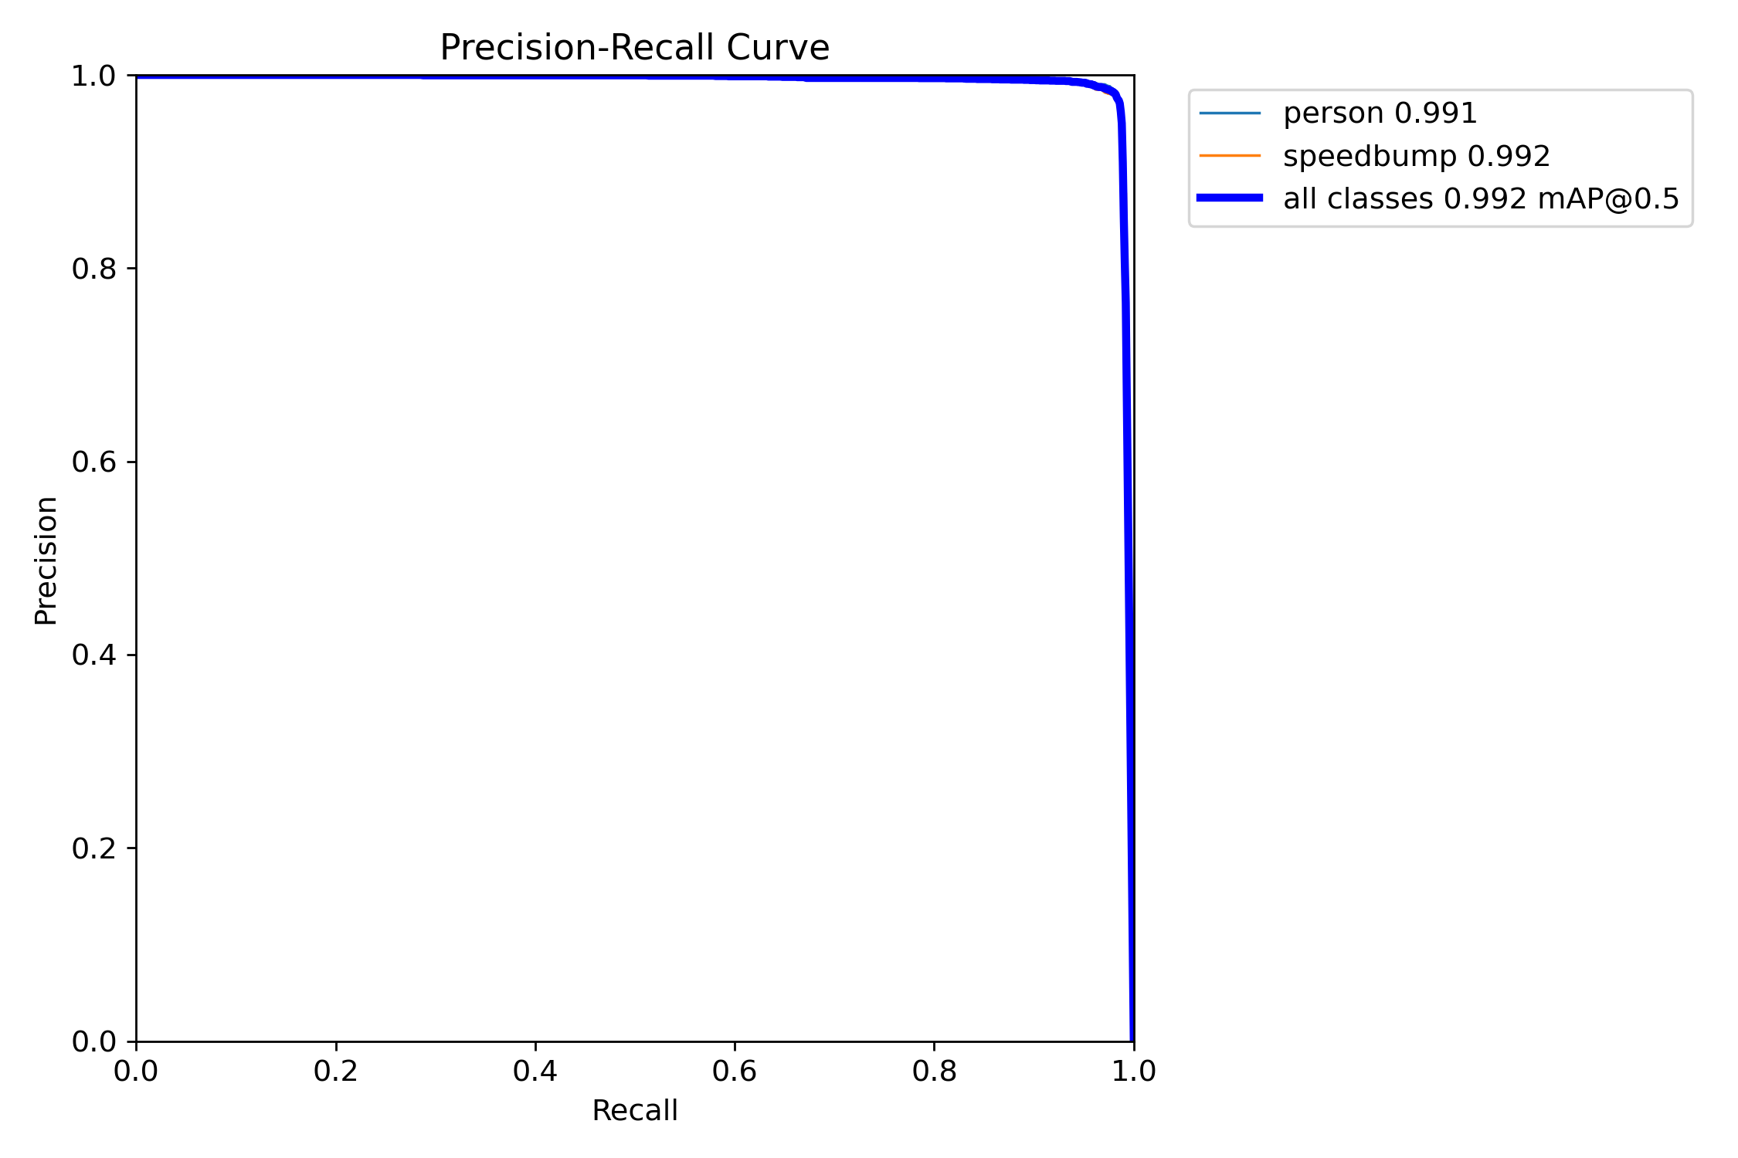
Target Detection
The curve bends upward and to the left, indicating high precision at low confidence levels, high recall rate, and low false alarm rate.
The curve approaches the top-right corner, demonstrating a balance between high recall rate and high precision.
The curve is close to the top-right corner, indicating high precision and high recall rate, with accurate prediction results.

Slide 11
04
Distance Measurement
Measuring the Distance Between the Camera and the Speedbump

Slide 12
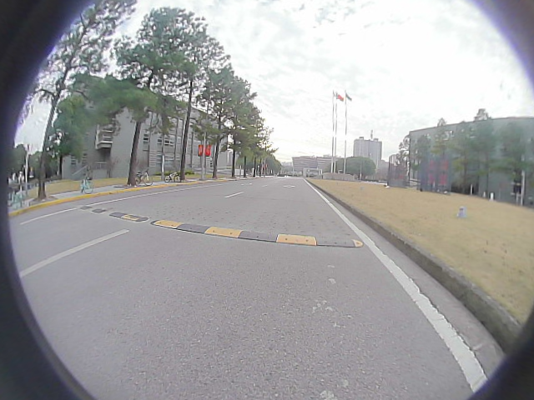
Distance Measurement
Based on camera calibration and homography matrix, we calculate the image coordinates of the center point of the speed bump bounding box detected by YOLOv8. Then, we use the homography matrix to map the image coordinates of the speed bump to the actual coordinates on the road plane. After that, we can calculate the distance between the camera and the speed bump.
Specifically:
Construct homogeneous coordinates: Convert the point (x, y) in the image to homogeneous coordinates [x, y, 1] to facilitate matrix operations.
Apply the homography matrix: Use the homography matrix to map the homogeneous coordinates to world coordinates, obtaining world_point.
Normalize coordinates: Normalize the coordinates by dividing the last element of world_point by itself, ensuring the last element is 1.
Calculate distance: Extract the Y-axis coordinate value of world_point and convert it to a vertical distance in meters by dividing by 1000.

Slide 13
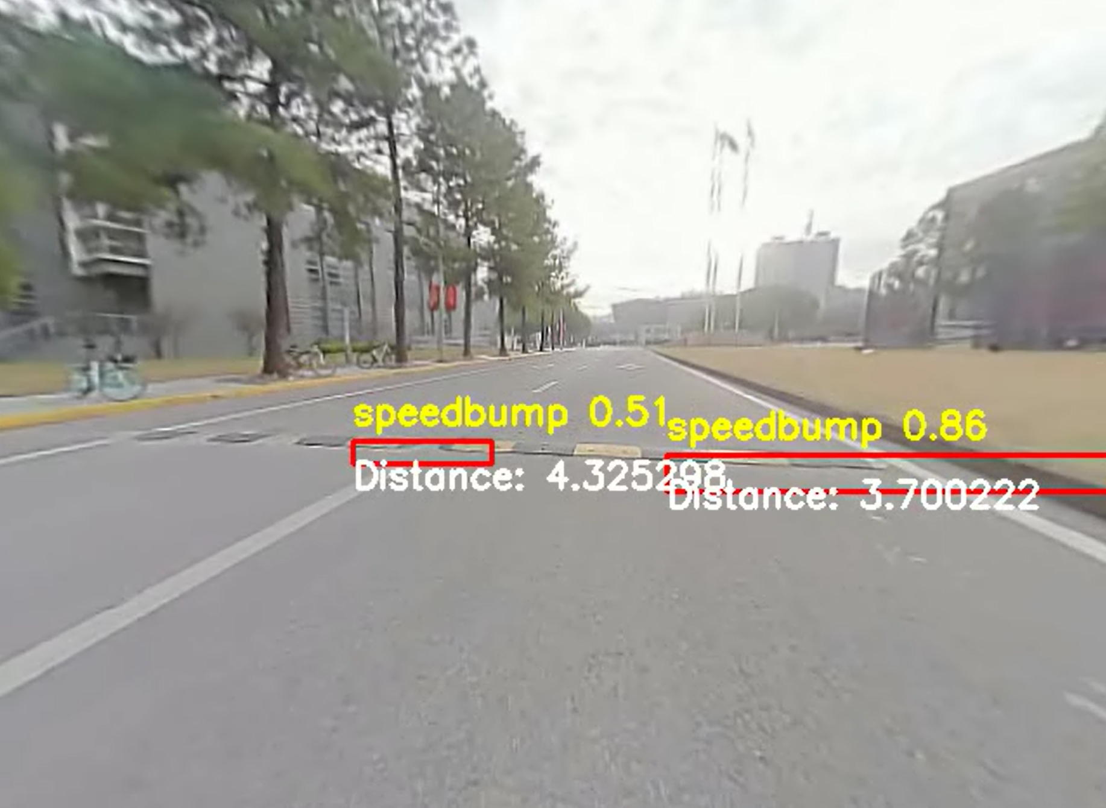
Distance Measurement
We annotated the position and distance information of the speed bumps on the image to visually demonstrate the distance measurement results.

Slide 14
05
Results Presentation
Speedbump Detection and Distance Measurement

Slide 15
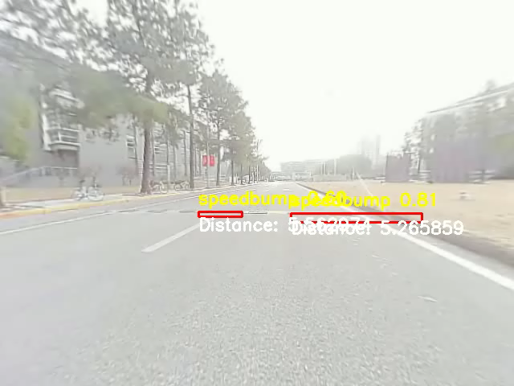
Results Presentation
Through camera calibration, the homography matrix, and object detection, we successfully achieved the detection and distance measurement of speed bumps.

Slide 16
Speedbump Detection and Distance Measurement
Thanks！
Final Project for Computer Vision
Team Members：
2250758 Jishen Lin
2251730 Shuyi Liu
2024 / 12 / 27

